Slide 1

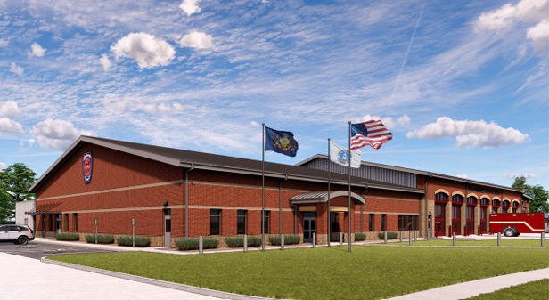

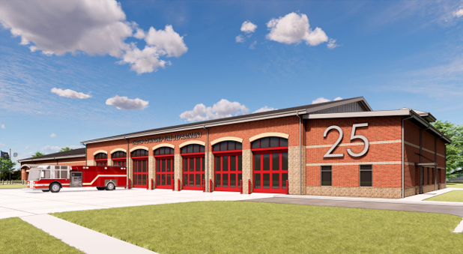
Exeter Township
EMERGENCY SERVICES CENTER
70 Gibraltar Road
July 2026

Slide 2


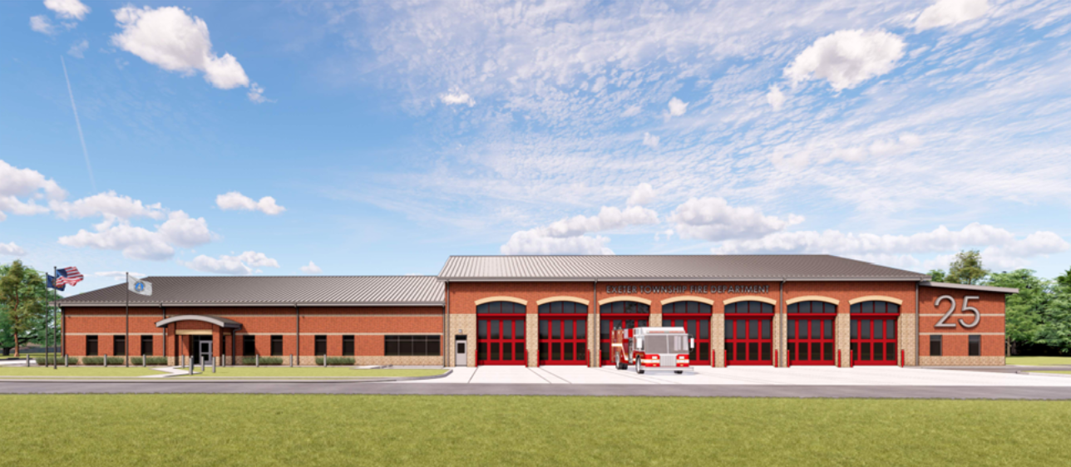
EXETER TOWNSHIP EMERGENCY SERVICES CENTER
Address Assigned – 70 Gibraltar Road

Slide 3
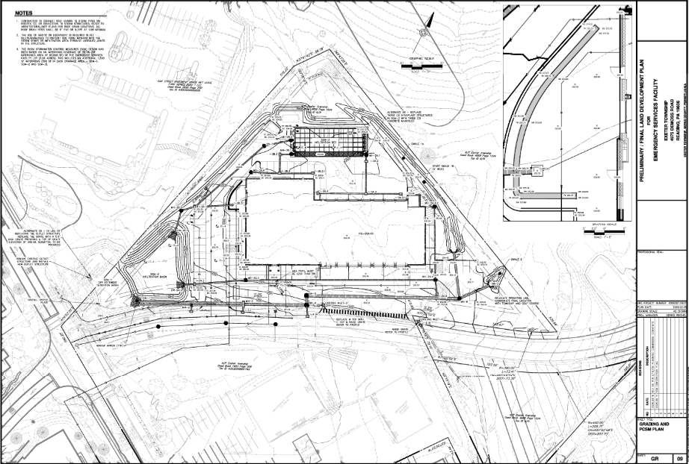
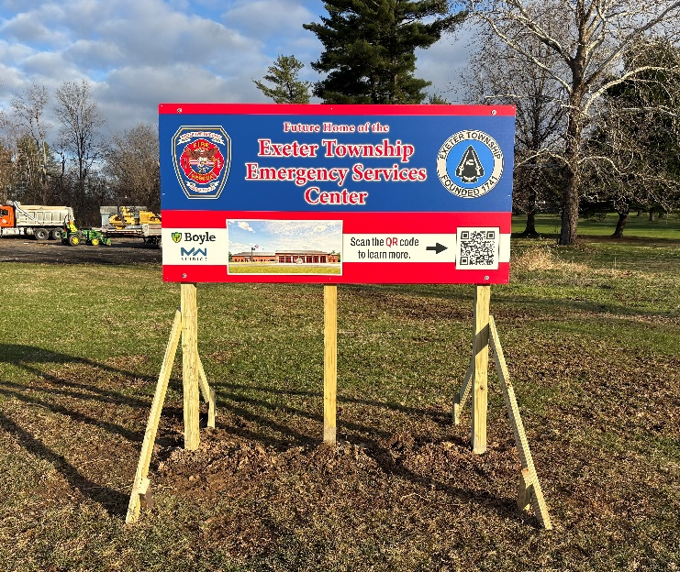

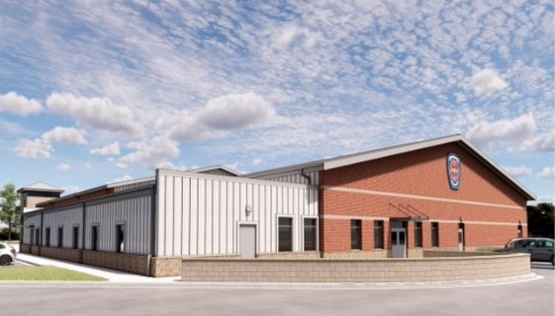
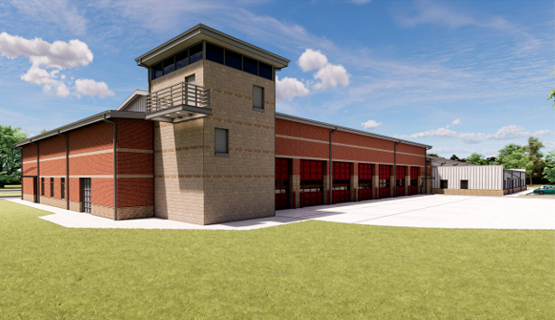
EXETER TOWNSHIP EMERGENCY SERVICES CENTER
Site Plan
Doctor’s Office Building
Exeter Township
Emergency Services Center
Reading Country Club
Gibraltar Road
DeMoss Road
Exeter Township Municipal Campus

Slide 4
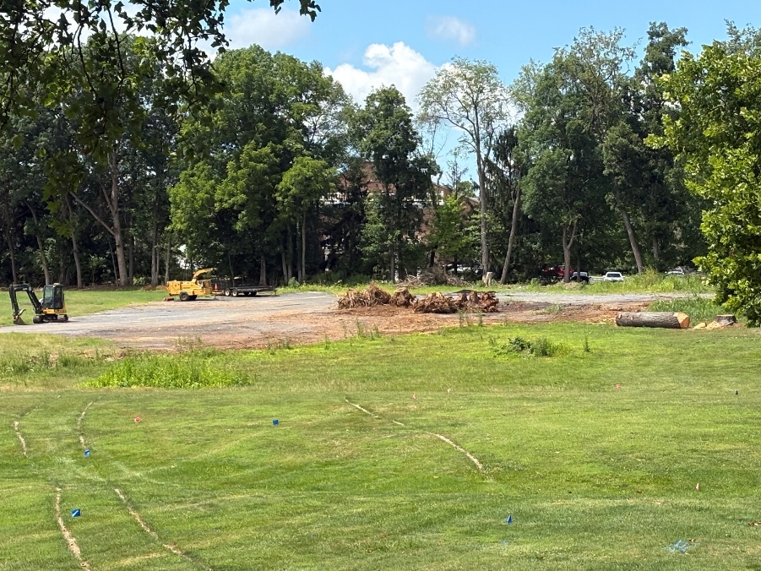
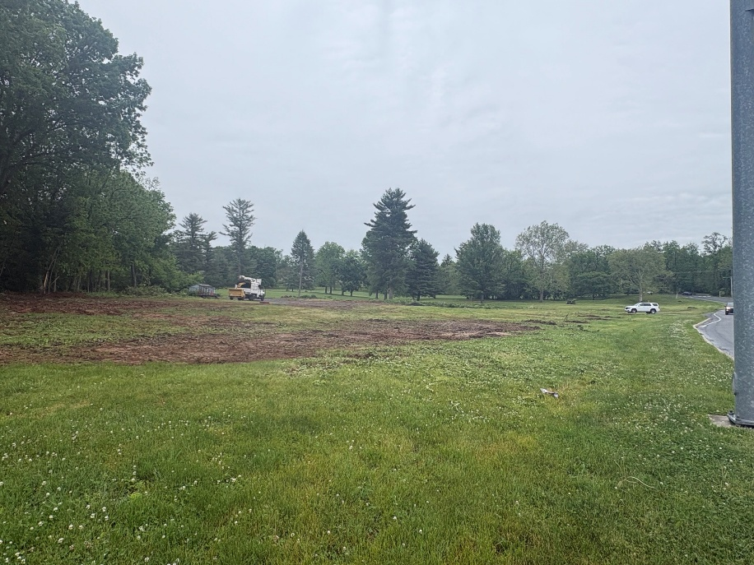
EXETER TOWNSHIP EMERGENCY SERVICES CENTER
EXETER TOWNSHIP EMERGENCY SERVICES CENTER
Work Completed
Front-End Specifications draft is being completed and reviewed.
Logistics and Phasing Plans are being completed and will be reviewed with Design Team and Township.
Finish selections are being finalized and integrated into the design documents.
Site Clearing
Work In Progress
Front-End Specifications being reviewed by Township Solicitor.
Owner Vendors design meetings continuing with Design Representative Review Meetings for specific products. Coordination into construction documents to continue.
Utility Service submissions and Utility Company Design in progress.
Design is progressing towards 90% Construction Documents deliverable at the end of August.

Slide 5
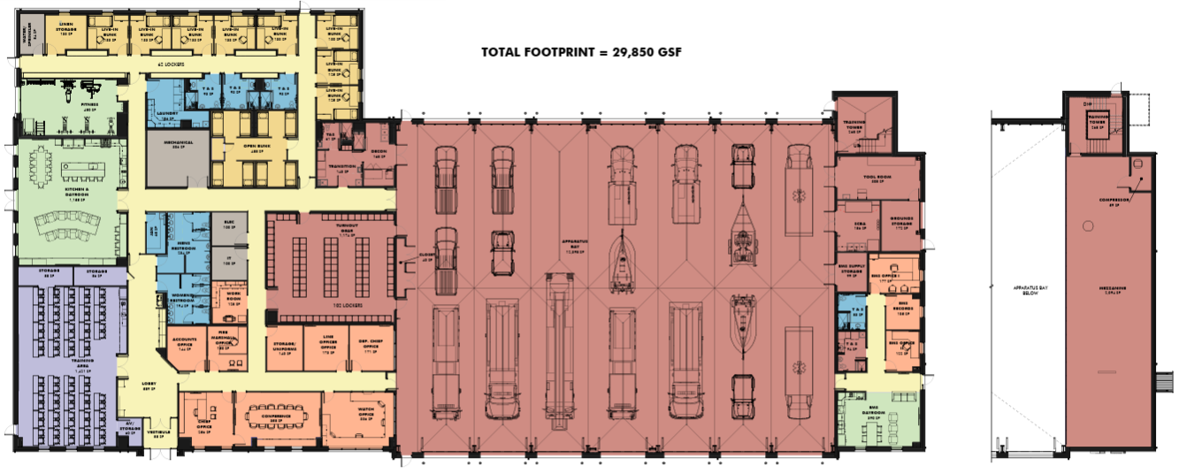
EXETER TOWNSHIP EMERGENCY SERVICES CENTER
First Floor Finish Plan

Slide 6
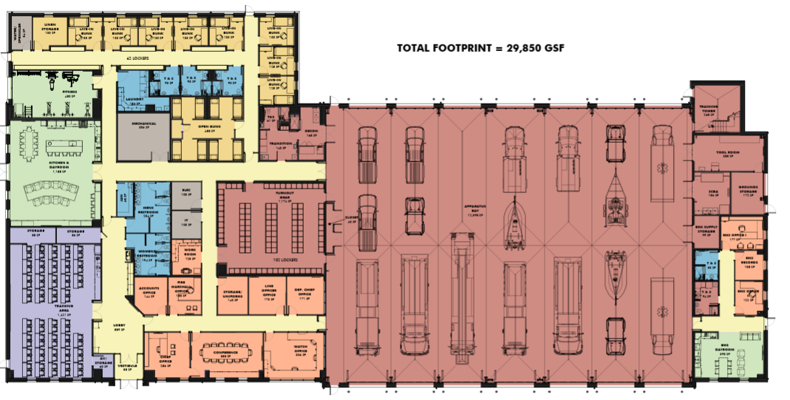

EXETER TOWNSHIP EMERGENCY SERVICES CENTER

Slide 7
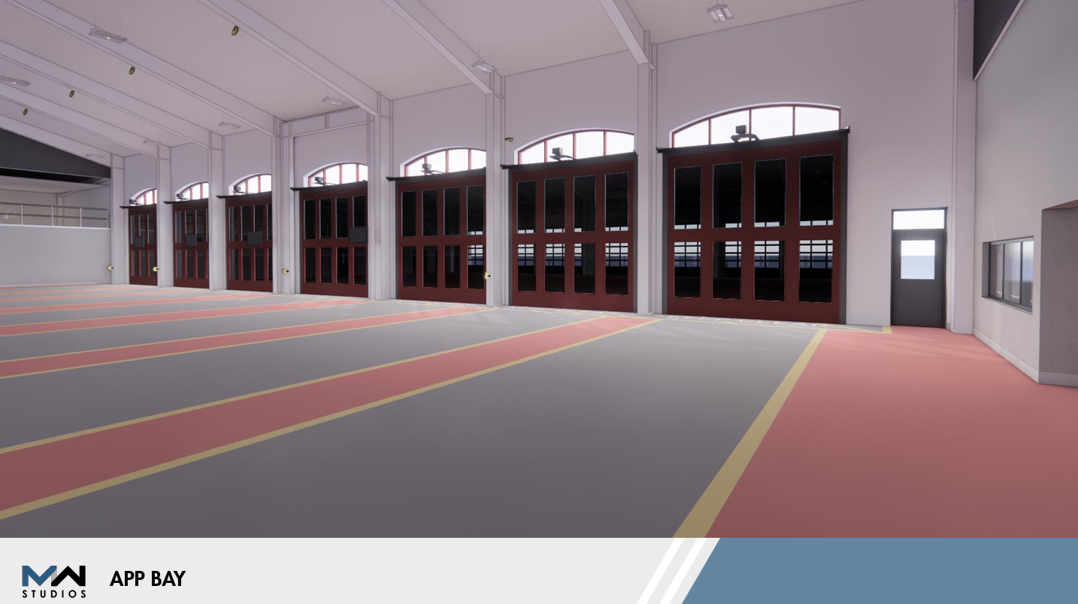

EXETER TOWNSHIP EMERGENCY SERVICES CENTER
Front
Apparatus Bays
7 Bays
(Drive Thru)
Fire and EMS

Slide 8
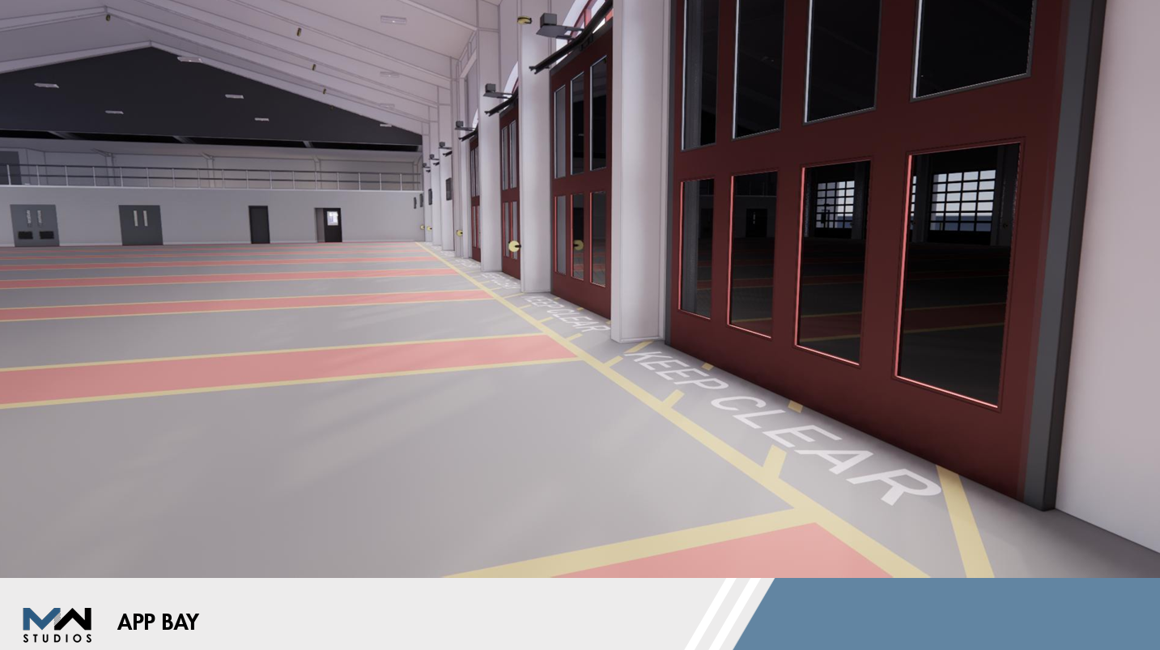
EXETER TOWNSHIP EMERGENCY SERVICES CENTER
Front
Apparatus Bays

Slide 9
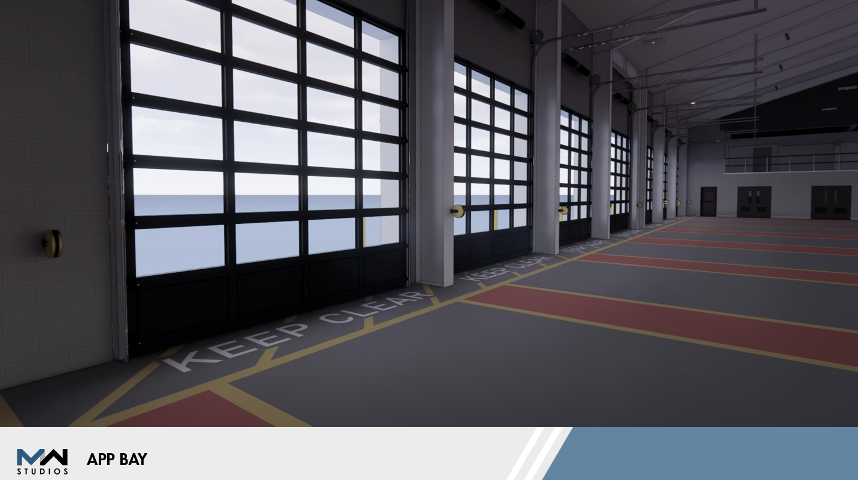
EXETER TOWNSHIP EMERGENCY SERVICES CENTER
Rear
Apparatus Bays

Slide 10
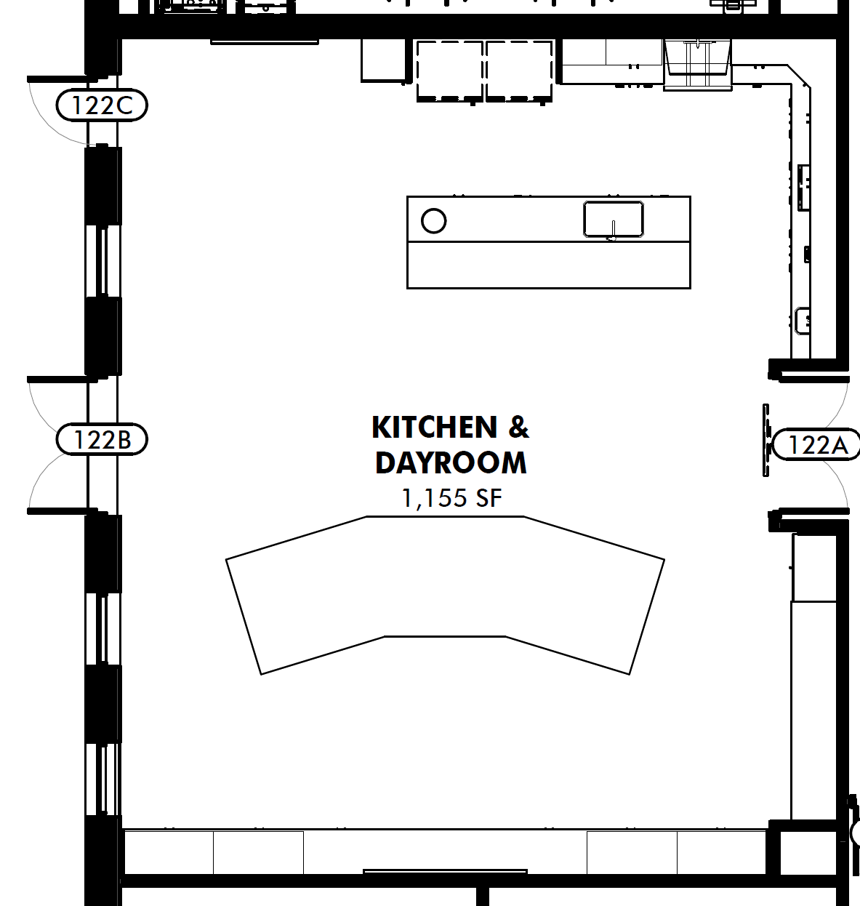
EXETER TOWNSHIP EMERGENCY SERVICES CENTER

Slide 11
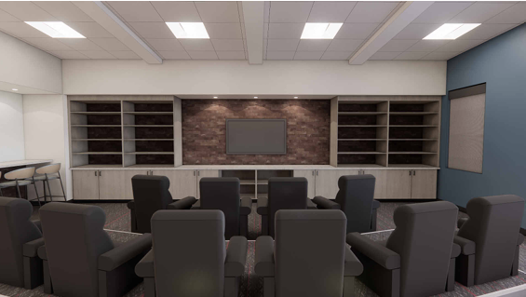
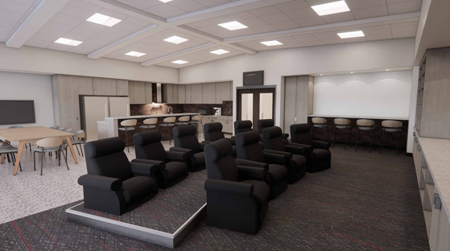

EXETER TOWNSHIP EMERGENCY SERVICES CENTER
Firefighter
Living Room Area

Slide 12
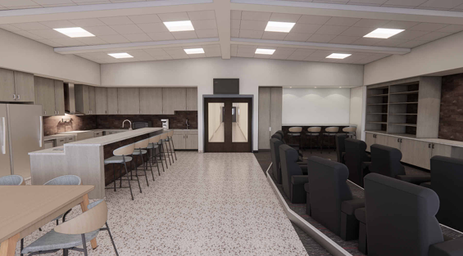
EXETER TOWNSHIP EMERGENCY SERVICES CENTER
Firefighter Living Room to Kitchen

Slide 13
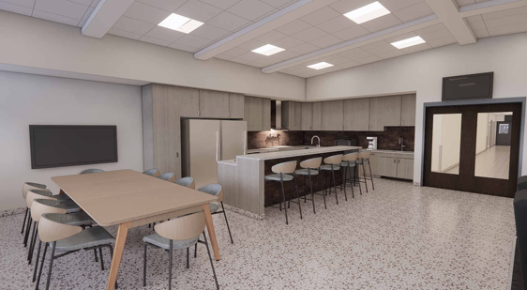
EXETER TOWNSHIP EMERGENCY SERVICES CENTER
Firefighter
Kitchen Area

Slide 14
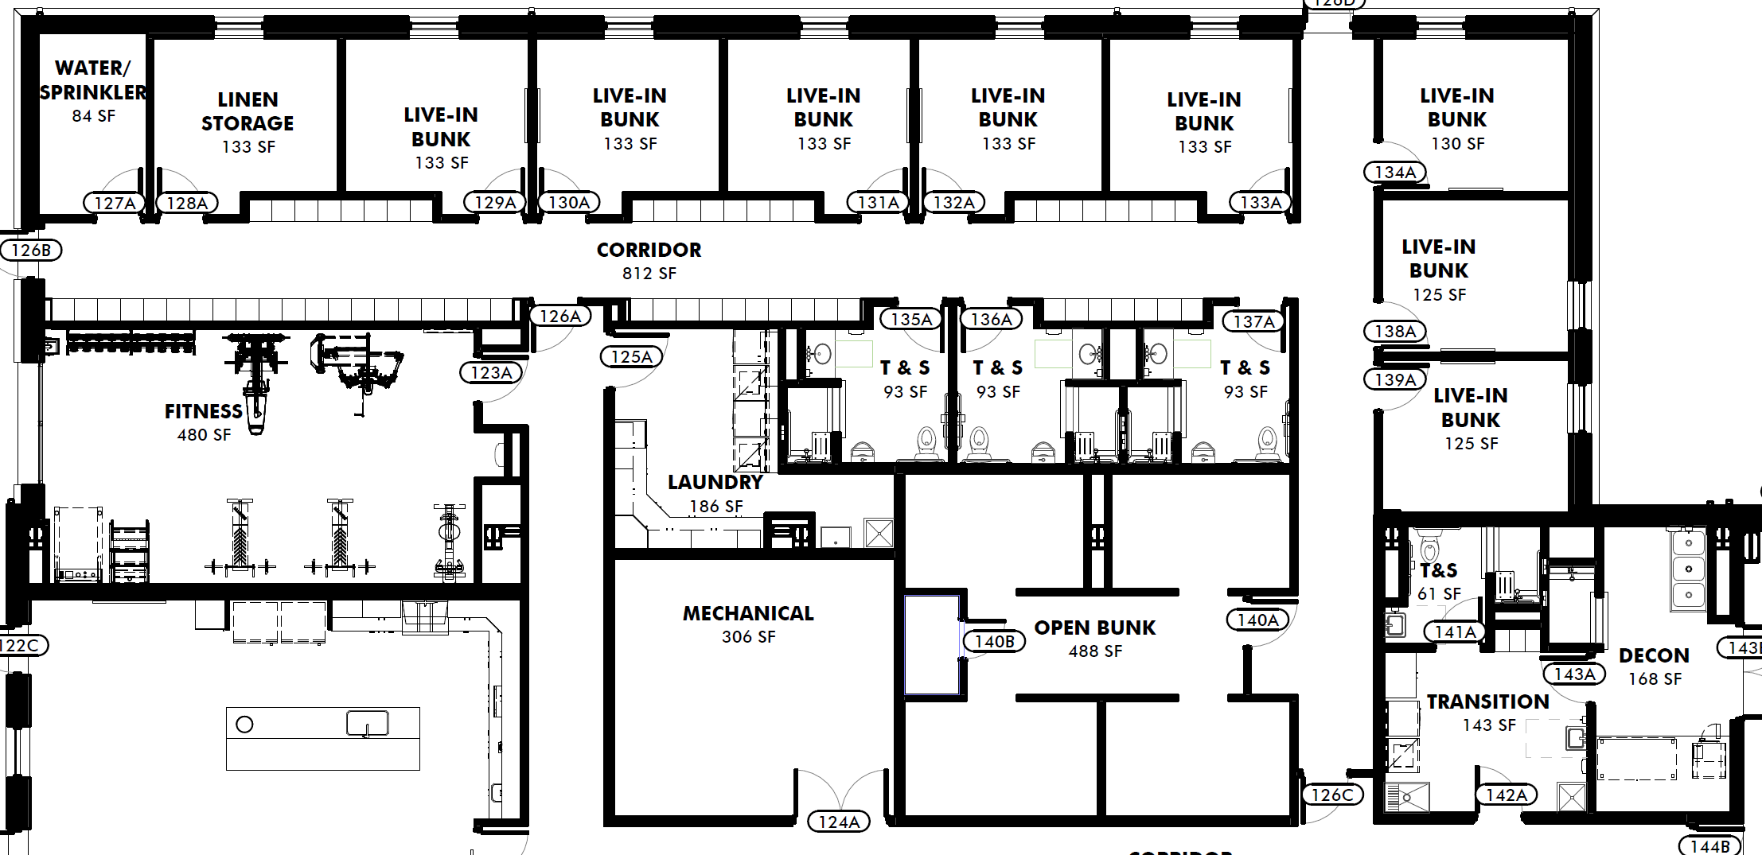
EXETER TOWNSHIP EMERGENCY SERVICES CENTER
8 Individual Bunk Rooms
Open Bunk Room to Sleep 8
Fitness Area
Decontamination Areas

Slide 15
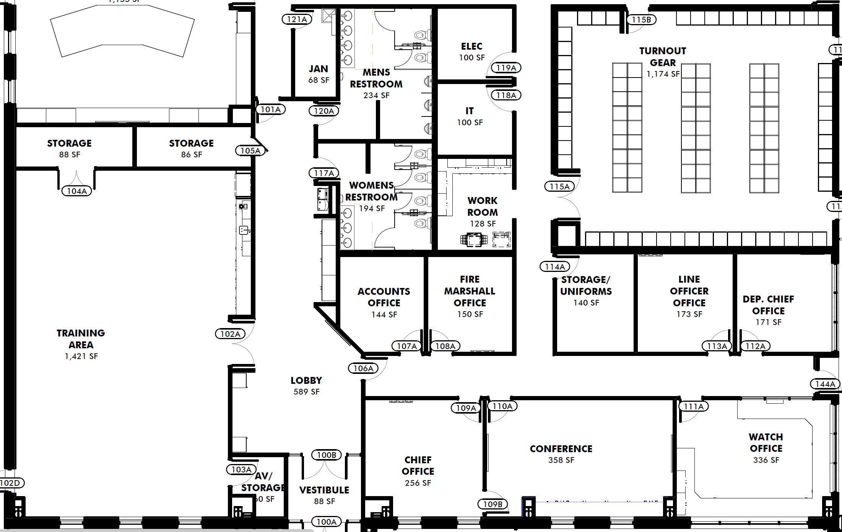
EXETER TOWNSHIP EMERGENCY SERVICES CENTER
9-11 Memorial
Training Room to Seat 75 to 100
Offices with Conference Room
Turnout Gear Area for 100+
Lobby with 9-11 Memorial

Slide 16
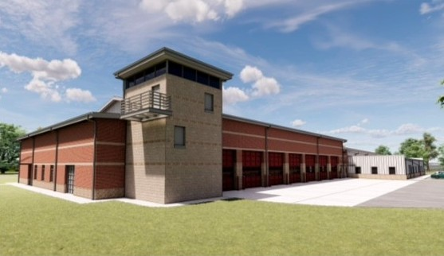
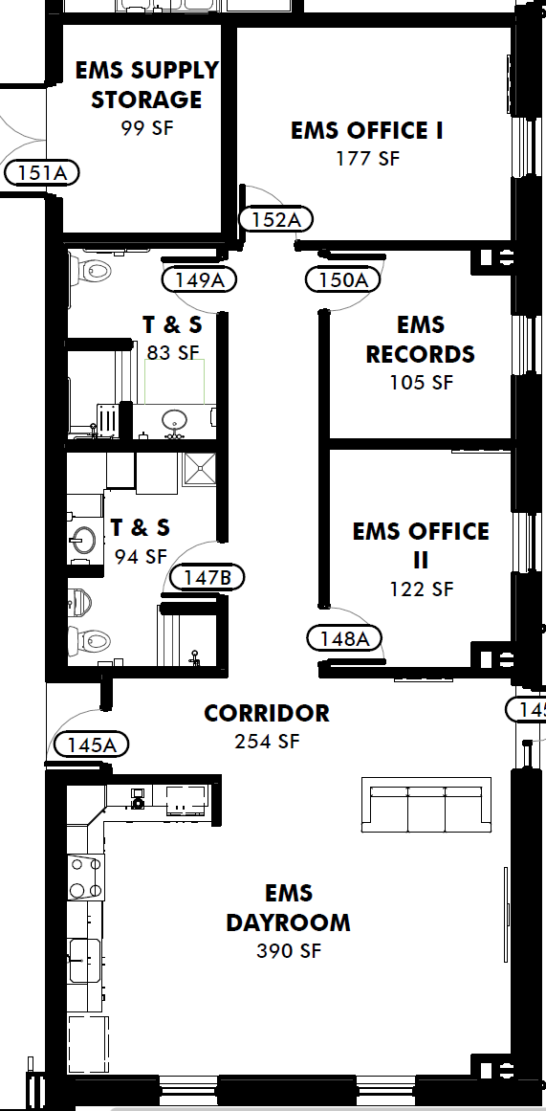
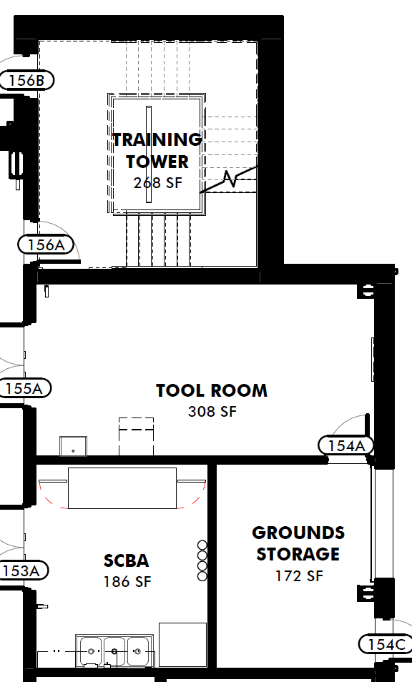
EXETER TOWNSHIP EMERGENCY SERVICES CENTER
Three Story Training Tower
Tool and SCBA Room
EMS Offices and Living Space
Mezzanine for Storage

Slide 17
EXETER TOWNSHIP EMERGENCY SERVICES CENTER
Overall Project Schedule
Exeter Emergency Services Center Bidding Schedule | Bidding Schedule
Advertisement 1 | Monday, September 21, 2026
Advertisement 2 | Tuesday, September 29, 2026
Advertisement 3 | Monday, October 5, 2026
Documents Available to Contractors | Monday, October 5, 2026
Mandatory Pre-Bid Meeting Date | Wednesday, October 7, 2026
Last Day to Submit RFI's | Thursday, October 29, 2026
Issue Final Addendum | Thursday, November 5, 2026
Documents in Contractors Hands | 10/5/26 - 11/12/26 (29 Days)
Bid Due Date | Thursday, November 12, 2026
Review Bids with Leadership Team & Prepare Recommendation | 11/13/26 - 11/18/26
Supervisor's Meeting to Approve Bids w/ Selected Alternates | Monday, November 23, 2026
Issue Intent to Award Letters | Tuesday, November 24, 2026
Issue Notice to Proceed | Monday, December 14, 2026

Slide 18
EXETER TOWNSHIP EMERGENCY SERVICES CENTER
Funding for Emergency Services Center (Private / State)
$1,500,000 | Private Donors to Exeter Township
$1,500,000 | 2026 RACP Award (Matching)
$500,000 | 2024 RACP Award (Matching)
$700,000 | Private Donations / Grants
$300,000 | Community Funding
$4,500,000 | Total Secured Funding (Private / State)
Open Funding Opportunities
$3,000,000 | Sen. Fetterman - Congressionally Directed Spending (CDS)
$3,000,000 | Rep. Houlahan - Community Project Funding (CPF)
$3,000,000 | Redevelopment Assistance Capital Program (RACP)
$1,000,000 | Local Share Account (LSA) - Statewide
$75,000 | Penn National Grant
$10,075,000 | Total Open Funding Opportunities

Slide 19
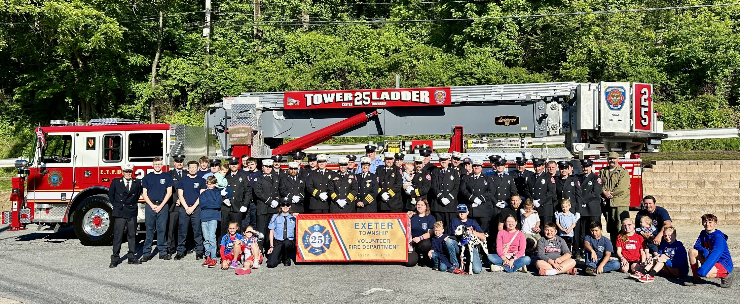
EXETER TOWNSHIP EMERGENCY SERVICES CENTER
Open Spring 2028 to Protect and Serve!
Any Questions?

